Slide 1
V. Modules

Slide 2
Modules
Module - a file containing Python definitions and statements. The file name is the module name with the suffix .py appended.

Slide 3
Python standard libraries
Standard modules: pre-built in the system, ready for python to import.
E.g.:
Sys – used to understand and manipulate the system
NumPy – used for large, multidimensional arrays & matrices
Pandas - providing high-performance, easy-to-use data structures and data analysis tools

Slide 4
Import, import as
import moduleName
import moduleName as name
Eg.:
>>> import sys
>>> import numpy
>>> import pandas
Eg.:
>>> import sys as s
>>> import numpy as np
>>> import pandas as pd

Slide 5
Functions within modules
import moduleName: moduleName.functionName()
import moduleName as name: name.functionName()
E.g.:
o = os.systems()

Slide 6
Functions within modules
from moduleName import functionOne, functionTwo
from moduleName import *
E.g.:
>>> from os import system
>>> from numpy import array, arange

Slide 7
Sys module, sys.path
import sys
print(sys.path)
Sys.path.append(‘custom path’)
print(sys.path)
Imports the sys module
Prints the list of locations that the system path could import from.
Adds a custom path to the sys.path list of locations.
Prints the list of locations that the system path could import from, the latest path should be added.

Slide 8
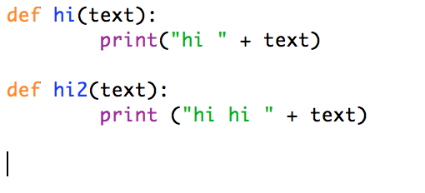
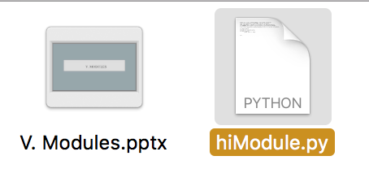
Writing your own module
Save in IDLE,
Should have .py ending

Slide 9
Importing your own modules
Open another new .py file to import your module!
import moduleName
import moduleName as name
from moduleName import functionOne, functionTwo

Slide 10
Example. himodule

Slide 11
Ex. himodule
Import hiModule
Import hi
Import hi2

Slide 12
Import your own modules!
Try importing your other modules into your modules!

